Slide 2
WRAP Application Training

Slide 3
WRAP Application Training

Slide 4
WRAP Application Training

Slide 5
WRAP Application Training

Slide 6
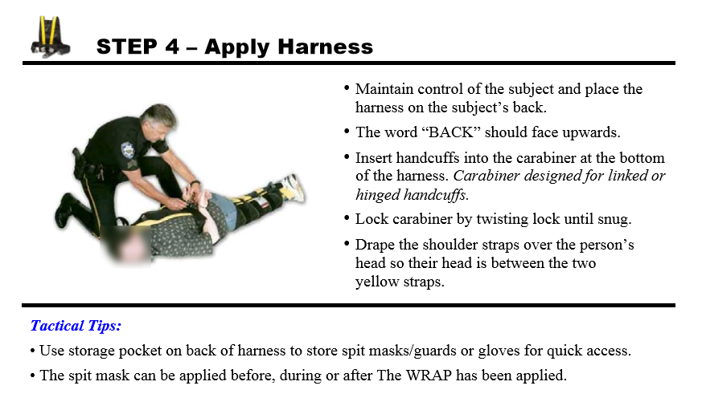
WRAP Application Training

Slide 7
WRAP Application Training

Slide 8
WRAP Application Training

Slide 9
WRAP Application Training

Slide 10
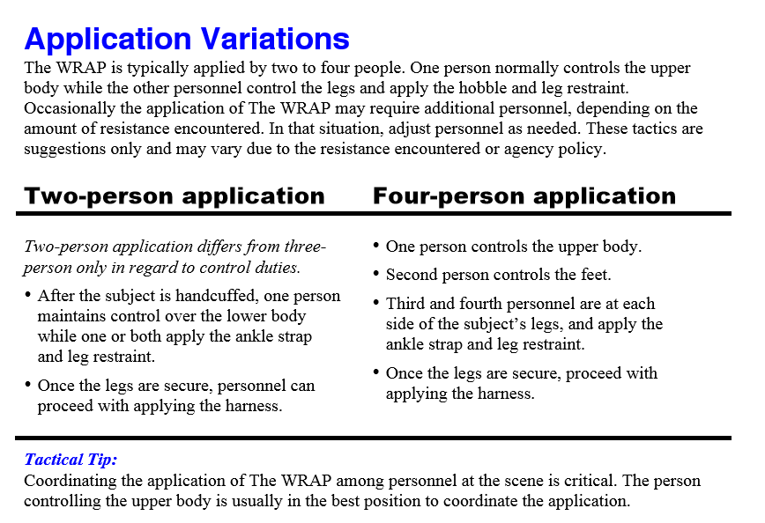
WRAP Application Training

Slide 11
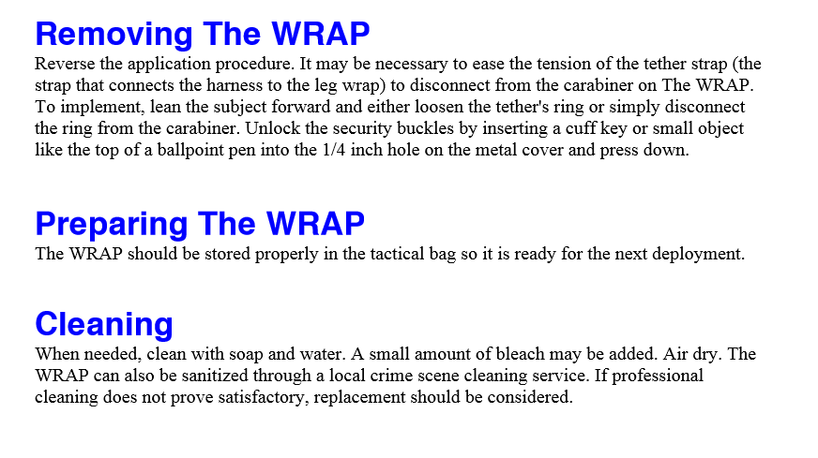
WRAP Application Training

Slide 12
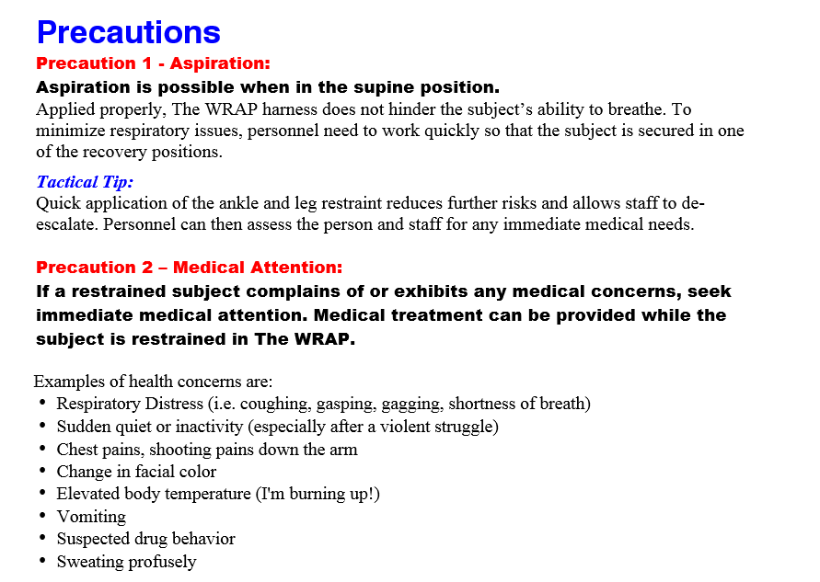
WRAP Application Training

Slide 13
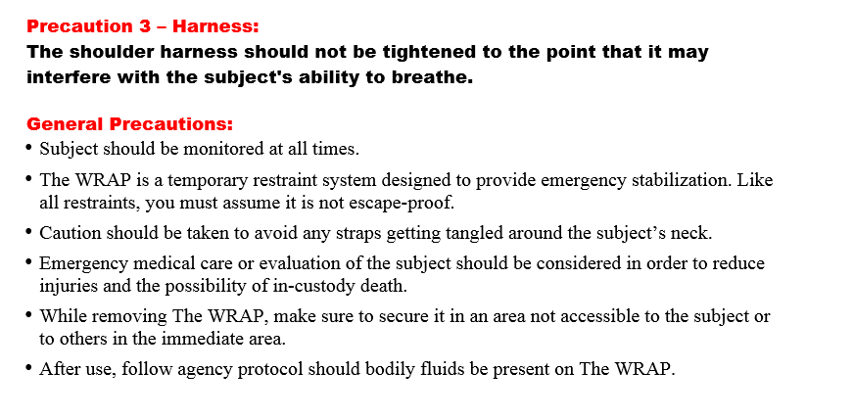
WRAP Application Training

Slide 14
Thank You
Safe Restraints Inc. / The WRAP

